Slide 1
INSA Text mining
11/10/2019

Slide 2

INSA text mining introduction
Who are we ?
Hugo SECHIER
Hugo.sechier@expleogroup.com
Anthony LAFFOND
Anthony.laffond@expleogroup.com

Slide 3
Contents
Table of contents
I. EXPLEO
Company presentation
III. What is text mining ?
Subjects examples
IV. Applications
Preprocessing
DTM
TFIDF
Dimension reduction
Web scraping
Sentimental analysis
Definition
II. Our use case
Presentation
Process
Data
Topic modeling

Slide 4
Contents
Table of contents
I. EXPLEO
Company presentation
III. What is text mining ?
Subjects examples
IV. Applications
Preprocessing
DTM
TFIDF
Dimension reduction
Web scraping
Sentimental analysis
Definition
II. Our use case
Presentation
Process
Data
Topic modeling

Slide 5
Company presentation
Some figures
employing
15,000+
technology loving
game-changers
€1.1bn
2018 revenue
25+
countries

Slide 6



Company presentation
We cover the full life cycle with end-to-end integrated solutions
Consulting
Engineering
Quality
Accelerating business agility, performance and digital transformation
• Strategy
• Management
• Execution
Managing critical and complex systems
• Design & product development
• Manufacturing and supply chain
• In-service support
Ensuring continuous quality in systems and applications
• Quality management
• Quality engineering
• Quality assurance

Slide 7
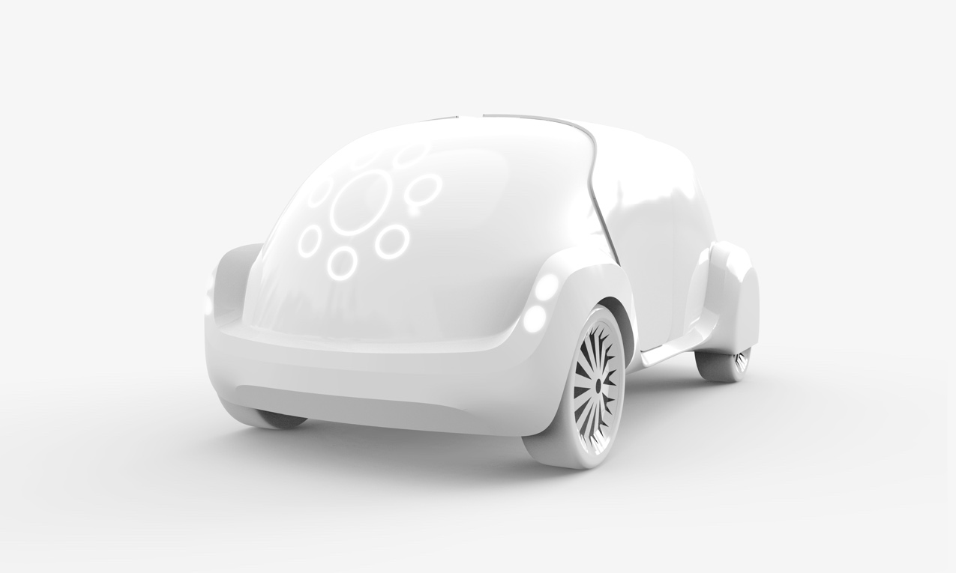
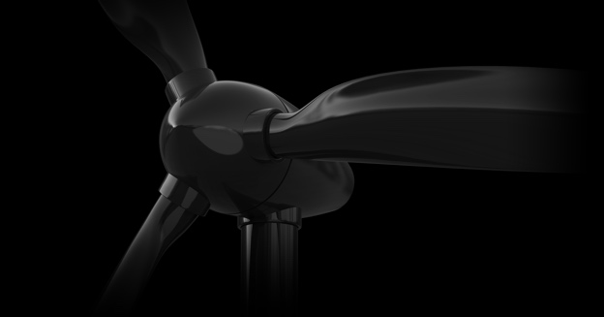

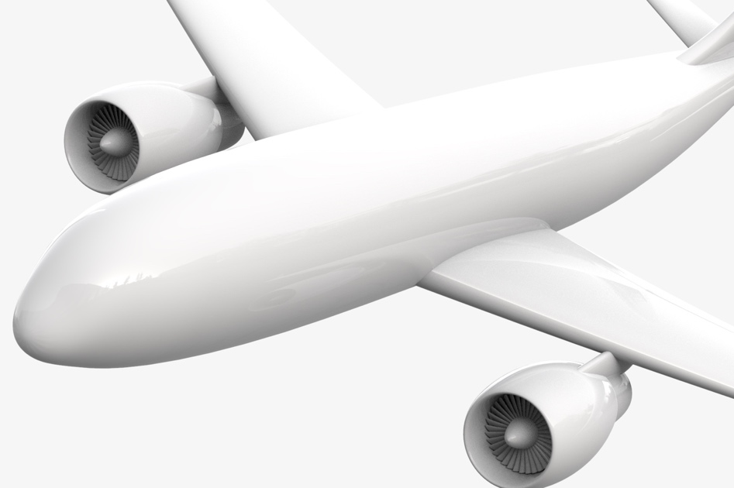
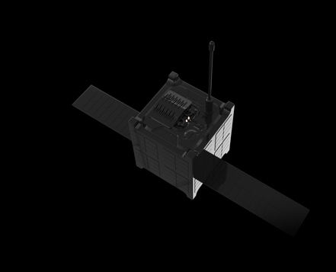


Company presentation
We are active in the
technology-intensive sectors
Aerospace
Automotive
Banking & Financial services
Defence
Energy & Utilities
Healthcare
Industrial
Insurance
Media
Naval
Public Sector
Retail & Logistics
Telecoms
Transportation

Slide 8


Company presentation
We are in a global technology race
Data science
Embedded Intelligence
Virtual Reality
Artificial
Intelligence
Safety
Businesses need to successfully transform their operating model by securing access to both key technologies and industry knowledge
Agility
Smart
Mobility
Connectivity
Regulation
Internet of Everything
Compliance
Sustainability
Cyber Security
Cloud Technology
Open
Source

Slide 9
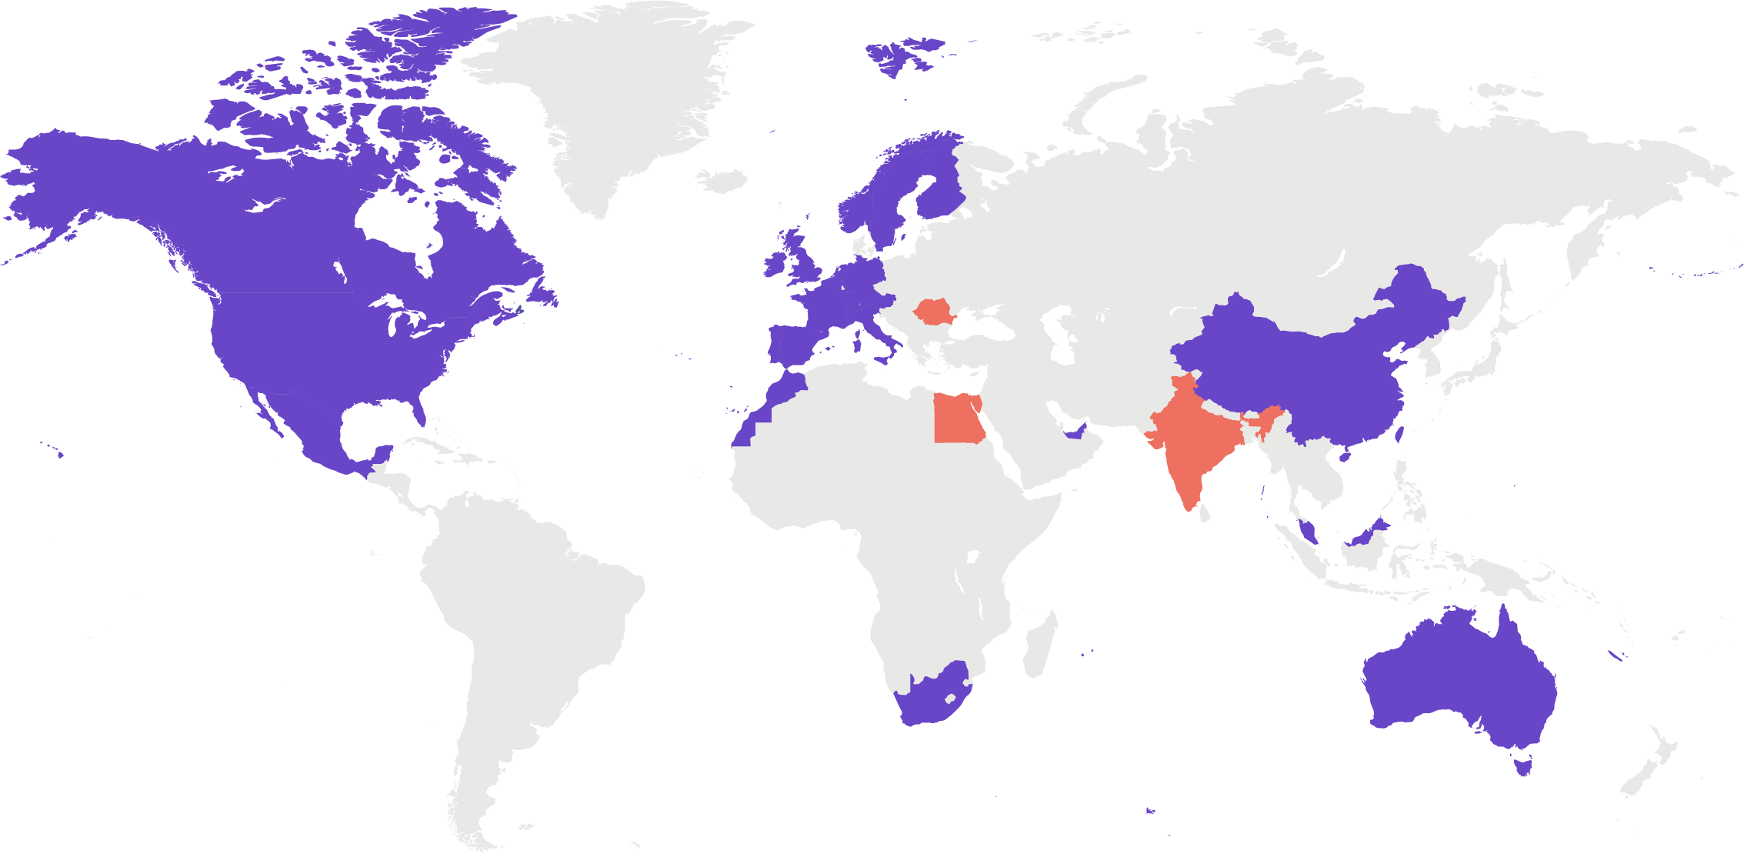
Company presentation
We operate a scalable and cost-
effective global delivery model
Strong pan-European presence with best-in-class technological centres
( )
Global excellence centres with unique bestshoring capabilities in Egypt, India and Romania
Fast-developing capabilities in North America and China
EUROPE
Austria
Belgium
Finland
France
Germany
Ireland
Italy
Netherlands
Norway
Portugal
Romania
Spain
Sweden
Switzerland
United Kingdom
NORTH AMERICA
Canada
Mexico
United States
ASIA
China
India
Malaysia
Singapore
UAE
AFRICA
Egypt
Morocco
South Africa
OCEANIA
Australia

Slide 10










Subjects examples
REFERENCES
Anomaly detection on Flight Tests
Correlation of parameters on Flight Tests
Scoring of Non Conformance on Supply Chain
Quality Classification with NLP
Search Engine for Non Quality
ChatBot interface for Manufacturing
Classification of delays for railway operation
Identification of influence factors on train delays
Analysis of air conditioning impact on reliability
Failure classification on maintenance report
OCR for REACH Database
Alloy Grains sizes classification based on Computer Vision
Striae detection
Biometric Fraud detection finger print, 3D visage
Face recognition on Social Network
Event detection in Tweets and Web flow
DBA
Reliability Crisis anticipation
Optimisation of Data Cleaning
Operational Reliability Data analysis
Data Visualisation
Reduction of energy consumption
Maintenance preparation
Predictive Maintenance

Slide 11
Subjects examples
REFERENCES
INSERTION DE SLIDES PROJETS ??

Slide 12
Contents
Table of contents
I. EXPLEO
Company presentation
III. What is text mining ?
Subjects examples
IV. Applications
Preprocessing
DTM
TFIDF
Dimension reduction
Web scraping
Sentimental analysis
Definition
II. Our use case
Presentation
Process
Data
Topic modeling

Slide 13
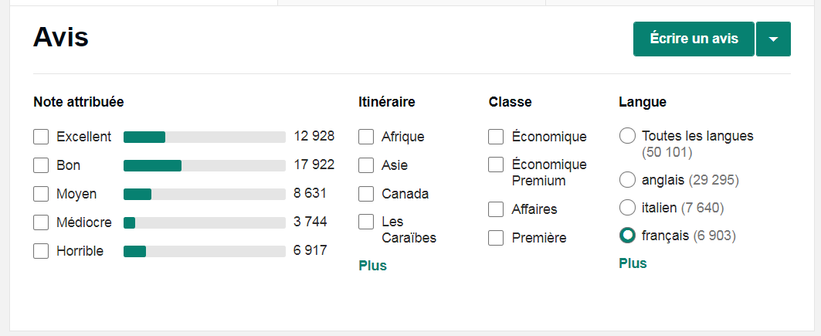
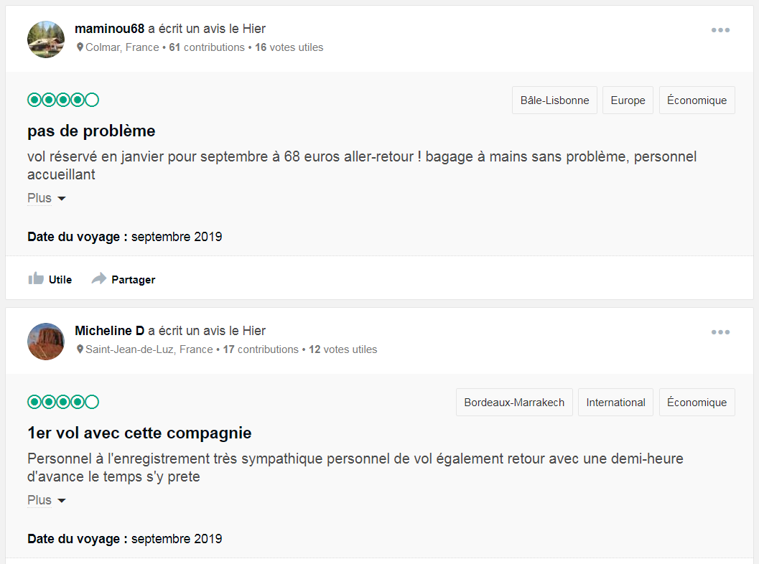
Our use case
Presentation
Your mission as an aircraft company
Want to automatically analyse reviews on your company and compare to others
Want to know the popularity evolution among time for all companies ?
Want to have a summary of what is say on all comments and by company ?

Slide 14
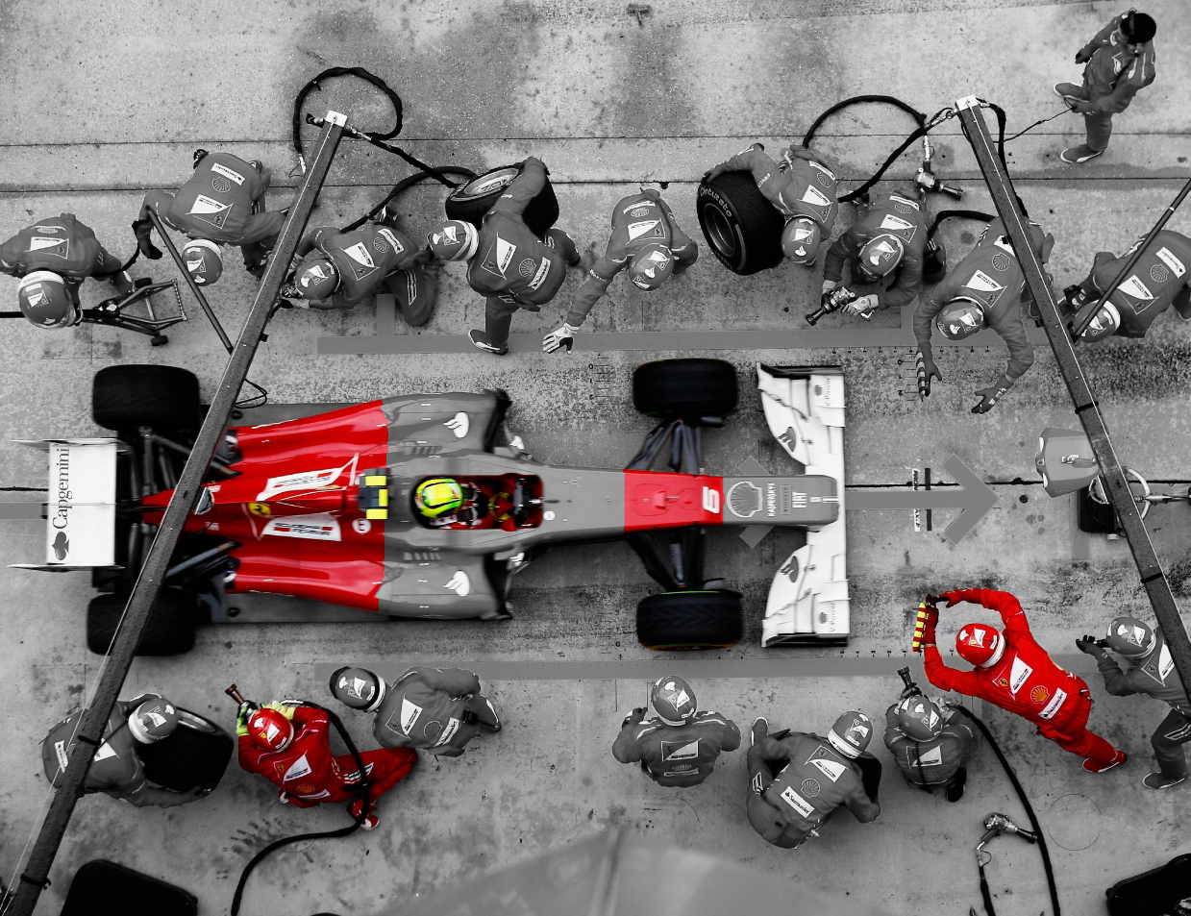
Our use case
Process
New Airline Company
Driver End-users
1
Fuel Data sources
2
Trip Advisor
5
4
Technical team Advanced analytics capabilities
You
3
1
3
Motor Robust technical platforms
Tools : PC, Python & open sources libraries
2
4
Tires & wheel Digital solutions & touchpoints
Infrastructure & Dashboarding
5

Slide 15
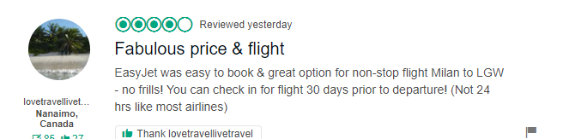
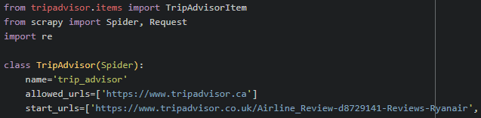
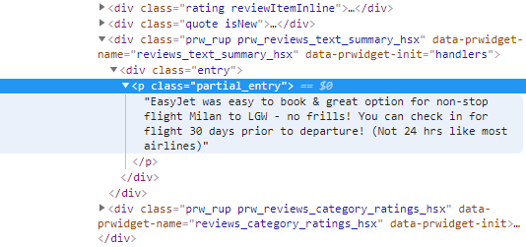
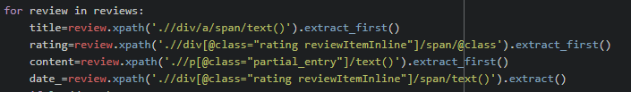
Our use case
Data
HTML structure
Scrapy Package on python
HTML is a page containing text arranged into elements, which have attributes
In your command prompt, type:
pip install scrapy
Documentation : https://scrapy.org/
Install package, import scripts
CTRL + MAJ + I
Create the scraping loop for each reviews

Slide 16
Contents
Table of contents
I. EXPLEO
Company presentation
III. What is text mining ?
Subjects examples
IV. Applications
Preprocessing
DTM
TFIDF
Dimension reduction
Web scraping
Sentimental analysis
Definition
II. Our use case
Presentation
Process
Data
Topic modeling

Slide 17

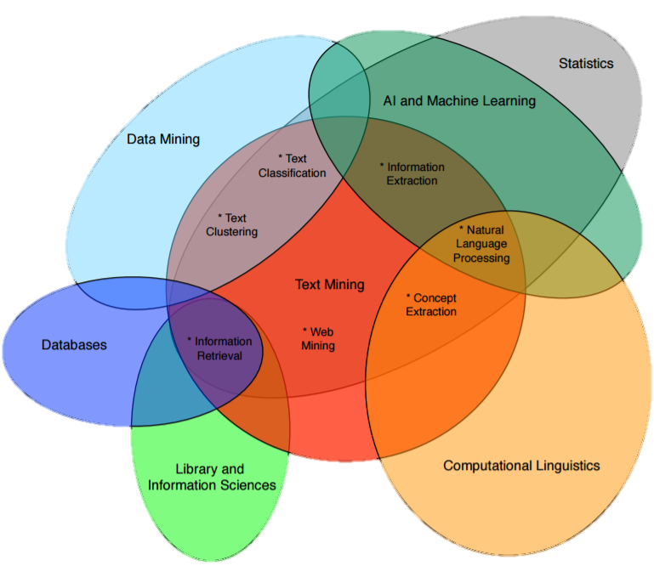
Text mining
Definition
Text Mining : Process of informations extraction from textual data and usage for multiple objectives.

Slide 18
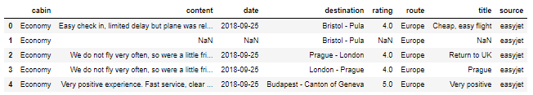
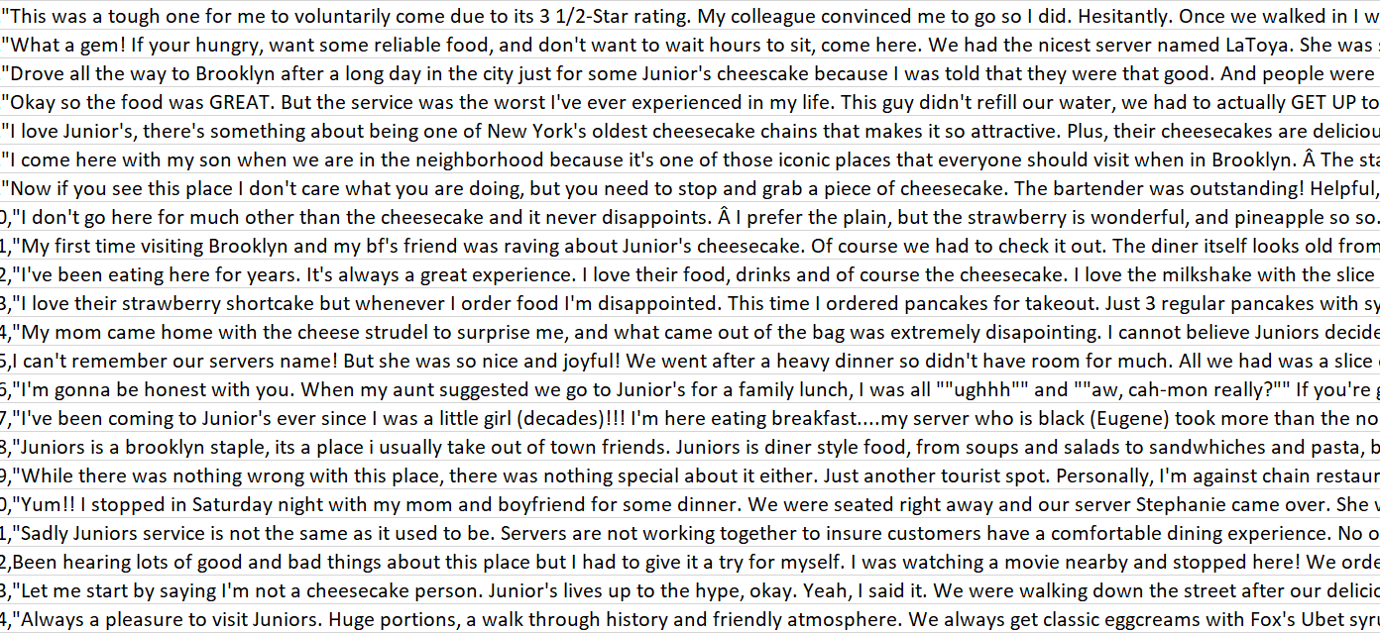
Text mining
Pre-processing
Descriptive Statistics
What processes should we apply on our data before anything to improve the quality of our analysis ?

Slide 19

Text mining
Pre-processing
Hi, I would like to knnow if you can explain me the famous RF classification algorithm ?
Ponctuation
Hi I would like to knnow if you can explain me the famous RF classification algorithm
Spelling
Hi I would like to know if you can explain me the famous RF classification algorithm
Stop words
Hi I would like to know if you can explain me famous RF classification algorithm
Dictionnary and Lexicon
Hi I would like to know if you can explain me famous Random Forest classification algorithm ?
Stemming & Lemmatisation
Hi I would like to know if you can explain me famous Random Forest classif algorithm ?

Slide 20
Text mining
Document term matrix
t₁ t₂ ∙ ∙ ∙ t_{d}
Document
The Assystem teams are trained to listen, acquire and develop skills, be able to adapt to the inherent challenges of innovation, risk control, complexity, and to convert our customers' goals into the results of our joint projects. With offices in 20 countries, our teams work every day around the world to
The Assystem teams are trained to listen, acquire and develop skills, be able to adapt to the inherent challenges of innovation, risk control, complexity, and to convert our customers' goals into the results of our joint projects. With offices in 20 countries, our teams work every day around the world to
w₁₁ w₁₂ ∙ ∙ ∙ w_{1d}
w₂₁ w₂₂ ∙ ∙ ∙ w_{2d}
∙ ∙ ∙
∙ ∙ ∙
∙ ∙ ∙
w_{t1} w_{t2} ∙ ∙ ∙ w_{td}
Cleaner energy, lighter aircraft, and electric modes of transport for the masses - these are a few of the challenges Assystem's customers face on a daily basis. Our 12.500 employees are committed to addressing these challenges with their know-how, methodologies and conviction.
cycle, coordinating and executing the realization of their projects and infrastructure
Cleaner energy, lighter aircraft, and electric modes of transport for the masses - these are a few of the challenges Assystem's customers face on a daily basis. Our 12.500 employees are committed to addressing these challenges with their know-how, methodologies and conviction.
cycle, coordinating and executing the realization of their projects and infrastructure
Cleaner energy, lighter aircraft, and electric modes of transport for the masses - these are a few of the challenges Assystem's customers face on a daily basis. Our 12.500 employees are committed to addressing these challenges with their know-how, methodologies and conviction.
cycle, coordinating and executing the realization of their projects and infrastructure
d₁
d₂
∙
∙
∙
d_{t}
 | years | Assystem | partner | … | … | …
D1 | 1 | 1 | 1
D2 | 0 | 1 | 0
D3
…
 | years | Assystem | partner
D1 | 1 | 1 | 1
D2
D3
…
 | years | Assystem | partner | … | … | …
D1 | 1 | 1 | 1
D2 | 0 | 1 | 0
D3 | 1 | 2 | 0
…
50 years of experience have made Assystem a key partner of the world's largest industrial groups: Airbus, Areva, Alstom, EDF,... Designing and developing the products and services of tomorrow, building and ensuring the optimum use of their investments throughout the life cycle, coordinating and executing the realization of their projects and infrastructure…
 | years | Assystem | partner | … | … | …
D1
D2
D3
…
50 years of experience have made Assystem a key partner of the world's largest industrial groups: Airbus, Areva, Alstom, EDF,... Designing and developing the products and services of tomorrow, building and ensuring the optimum use of their investments throughout the life cycle, coordinating and executing the realization of their projects and infrastructure…
50 years of experience have made Assystem a key partner of the world's largest industrial groups: Airbus, Areva, Alstom, EDF,... Designing and developing the products and services of tomorrow, building and ensuring the optimum use of their investments throughout the life cycle, coordinating and executing the realization of their projects and infrastructure…

Slide 21
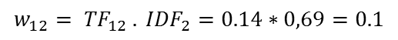
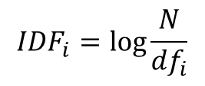
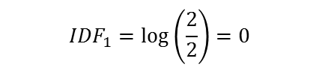
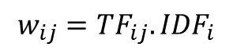
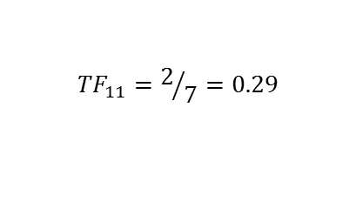
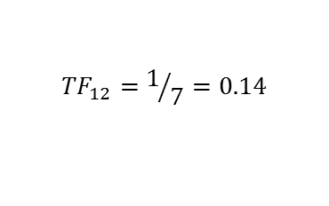
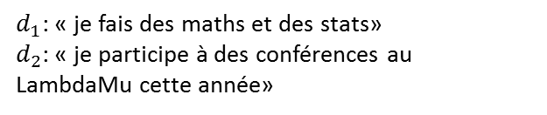
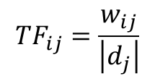
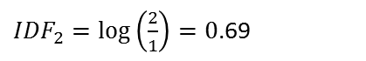
Text mining
DTM : Document Term Matrix
What kind of weight can we use in DTM?
$d_{1}$: « je fais des maths et des stats»
$d_{2}$: « je participe à des conférences au LambdaMu cette année»
Term Frequency (TF)
The more a term appears in a document, the more it contains informations.
des maths
$${TF}_{ij}=\frac{w_{ij}}{\left|d_{j}\right|}$$
d₁
d₂
w₁₁ w₁₂
w₂₁ w₂₂
Inverse Document Frequency (IDF)
A term that appears in few documents, is a better discriminant than another.
$${TF}_{11}=2/7=0.29$$
$${IDF}_{i}=\log{\frac{N}{{df}_{i}}}$$
$${TF}_{12}=1/7=0.14$$
des maths
TF-IDF
Is measuring the importance of a term in a document according to the corpus
d₁
d₂
0 0.1
0 0
$${IDF}_{1}=\log\left(\frac{2}{2}\right)=0$$
$$w_{ij}={TF}_{ij}.{IDF}_{i}$$
${IDF}_{2}=\log\left(\frac{2}{1}\right)=0$.69
t₁ t₂ ∙ ∙ ∙ t_{d}
$$w_{12}= {TF}_{12} . {IDF}_{2}=0.14∗0,69=0.1$$
d₁
d₂
∙
∙
∙
d_{t}
w₁₁ w₁₂ ∙ ∙ ∙ w_{1d}
w₂₁ w₂₂ ∙ ∙ ∙ w_{2d}
∙ ∙ ∙
∙ ∙ ∙
∙ ∙ ∙
w_{t1} w_{t2} ∙ ∙ ∙ w_{td}
$$w_{11}= {TF}_{11} . {IDF}_{1}= 0.29∗0= 0$$

Slide 22


Text mining
Tools for dimensionality reduction
Feature Selection
Dimension Reduction according to a measurement as frequency of words or TF-IDF
REVIEWS
X = pd.DataFrame(np.random.rand(50,100))
mesure = pd.DataFrame({ "col" : X.columns.values, "imp" : np.random.rand(100) })
col_to_select = measure.sort_values(by= "imp").head(k).col
Xp = X[col_to_select]
X
REVIEWS
Sorted by a measure
X’
WORDS
SELECTED WORDS
REVIEWS
SVD (Singular Value Decomposition)
Matrix Factorization Method
X
U
∑k
Vk
X.svd <- svd(X)
Sig <- diag(r.svd$d)
u <- r.svd$u
v <- r.svd$v
uk <- as.matrix(u[, 1:k])
vk <- as.matrix(v[, 1:k])
Sigk <- as.matrix(d[1:k, 1:k])
Xp <- uk %*% Sigk %*% t(vk )
∑
V
WORDS
≈
Uk
Take only the k first singular values

Slide 23
Text mining
Tools for dimensionality reduction
NMF (Non Negative Matrix Factorization)
Unsupervised data decomposition ( for topic learning, feature extraction or clustering)
REVIEWS
TOPICS
REVIEWS
from sklearn.decomposition import NMF
model = NMF(n_components=k, init='random')
W = model.fit_transform(X)
H = model.components_
X
W
H
TOPICS
≈
WORDS
WORDS
library(NMF)
nmf(X,k,"lee") # lee & seung method
from keras.layers import Input, Dense
from keras.models import Model
# Exemple : https://blog.keras.io/building-autoencoders-in-keras.html
Autoencoder
Artificial neural network used for unsupervised learning of efficient codings
REVIEWS
X
X’
WORDS
library(SAENET)
# Exemple : h
https://web.cs.dal.ca/~kallada/stat2450/lectures/Lecture17.pdf
ENCODER
CODE
DECODER

Slide 24
Contents
Table of contents
I. EXPLEO
Company presentation
III. What is text mining ?
Subjects examples
IV. Applications
Preprocessing
DTM
TFIDF
Dimension reduction
Web scraping
Sentimental analysis
Definition
II. Our use case
Presentation
Process
Data
Topic modeling

Slide 25
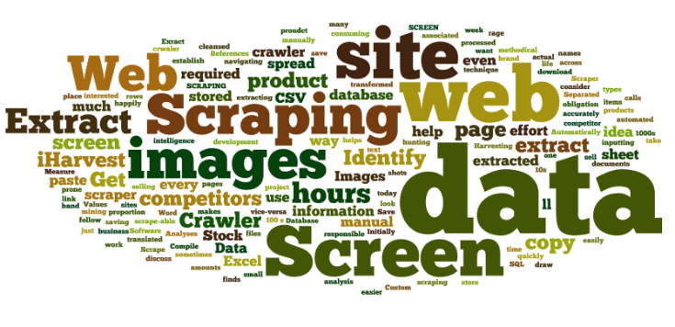





Applications
Web scraping
Why should we use Web scraping?
No structured Data available
Market Price Analysis (real-time competitiveness)
Market Intelligence
Sentiment Analysis (social reactions)
Which kind of Data are we looking for?
Price / Articles / Reviews
Metadata (number of connections, …)
Find sources we can use (API, Scraping)
What is the typical process?
Standardize dataframe structure
Build a Mapping (Excel, Trello, Turtle)
Ex.: Real-estate market analysis
Note: Trello: https://trello.com/, Turtle: https://turtle.ai/

Slide 26
Applications
Web scraping
HTML structure
Scrapy Package on python
HTML is a page containing text arranged into elements, which have attributes
In your command prompt, type:
pip install scrapy
Documentation : https://scrapy.org/
CTRL + MAJ + I
Create the scraping loop for each reviews

Slide 27
Applications
Topics extraction using LDA
How to define topics?
How to define that a document talks about a topic?
Is a document about one topic only?
Does a new document have new topics?
Can topics summarize documents?

Slide 28
Applications
Topics extraction using LDA
LDA : Latent Dirichlet Allocation → unsupervised algorithm for topic modelling
Automatic topic extraction
"people", "teenagers", "family"
Topic interpretation
Text samples
"Netflix", "TV shows", "season"
"learn", "teaches", "English"
Persons
Document 1
Document 2
TV shows
[...] People spend more time on Netflix than on [...]
[...] Black Mirror is NOT a show for the family [...]
Knowledge
Topic allocation
Document 1
Document 2
Document 3
Document 4
70%
20%
10%
50%
50%
[...] Teenagers watching TV shows learn better English [...]
[...] House of cards teaches the fundamentals of the mechanics of power [...]
Document 3
Document 4
75%
25%
15%
15%
70%
Tasks performed by a LDA model

Slide 29
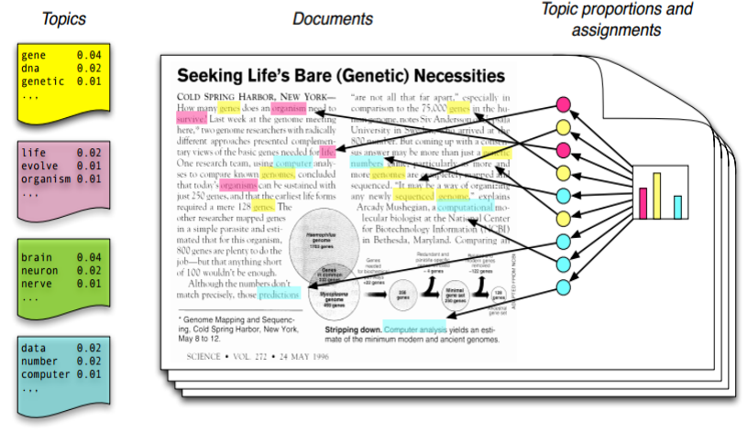
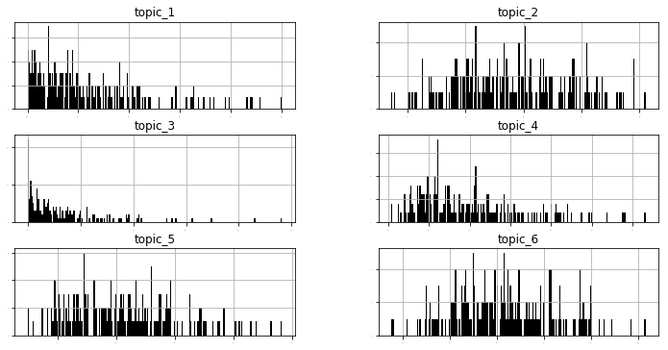
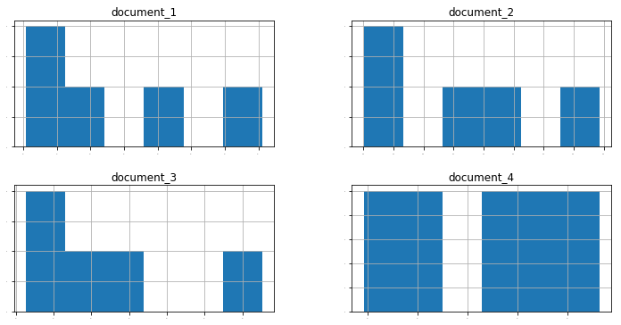
Applications
Topics extraction using LDA
LDA optimizes the probability that documents occur knowing topics are distributed among them
Topics are represented by different word probabilities
Similarly, documents are represented by different topic probabilities

Slide 30



Applications
Topics extraction using LDA
A 3-step approach to succeed in implementing LDA
Test algorithm on a sample of clean data
(optionally) Remove verbs and keep nouns with POS tagging
(optionally) Keep a minimal amount of nouns
Data preparation
Progressions
Fine-tuning model
Number of topics
Alpha & eta for topic & word distributions
Iterations and other parameters
Corrections
Interpretation Validation
Topics interpretation
Unicity and exhaustivity of topics
Topic allocation follows intuition

Slide 31




Applications
Sentiment analysis
Goal:
Find the polarity of a text (bad, neutral or good)
Applications:
Recommender system, social media opinion, Customer satisfaction, political opinion, etc..
Challenges:
Irony, complex sentences, domain specific keywords, context
Results:
According to research, human raters agree about 80% of the time, so an accuracy of 80% seems good
2 main approaches
Lexicon based
dictionary with a word and its polarity, some rules are generally added to take into account negation, case, punctuation and other grammatical rules
Machine Learning based
treating the problem as a classification or regression problem, works well with SVMs or NB

Slide 32

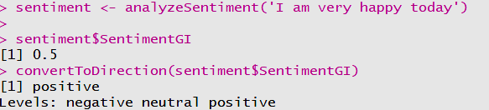

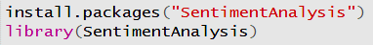
Applications
Sentiment analysis
There are several packages to do sentiment analysis in Python: NLTK, Vader (in NLTK), TextBlob, AFINN etc.
In R, there is the package: SentimentAnalysis
In [1]: from textblob import TextBlob
TextBlob(‘I am very happy today’).sentiment
Out[1]: Sentiment(polarity = 1.0, subjectivity = 1.0)

Slide 33

Way forward
To go further…
Feature Engineering and Selection CS 294: Practical Machine Learning. October 1st, 2009. Alexandre Bouchard-Côté https://people.eecs.berkeley.edu/~jordan/courses/294-fall09/lectures/feature/slides.pdf
Stemming and lemmatization An Introduction to Information Retrieval, 2009. Christopher D. Manning, Prabhakar Raghavan & Hinrich Schütze
http://nlp.stanford.edu/IR-book/html/htmledition/stemming-and-lemmatization-1.html

Slide 34
Anthony LAFFOND
Toulouse - FRANCE
T. +33 07 84 30 91 17
Anthony.laffond@expleogroup.com
Hugo SECHIER
Paris - FRANCE
T. +33 06 35 56 83 38
Hugo.sechier@expleogroup.com

